Slide 1

Delivery systems
Head of delivery systems: Dr. Maayan Eitan-Wexler
Team members:
Esther Dahari (Upstream)
Ophir Weinstein (Downstream)
*Itzhak Elhiv (ddPCR)

Slide 2
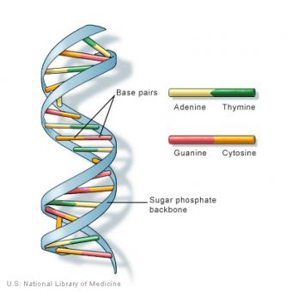
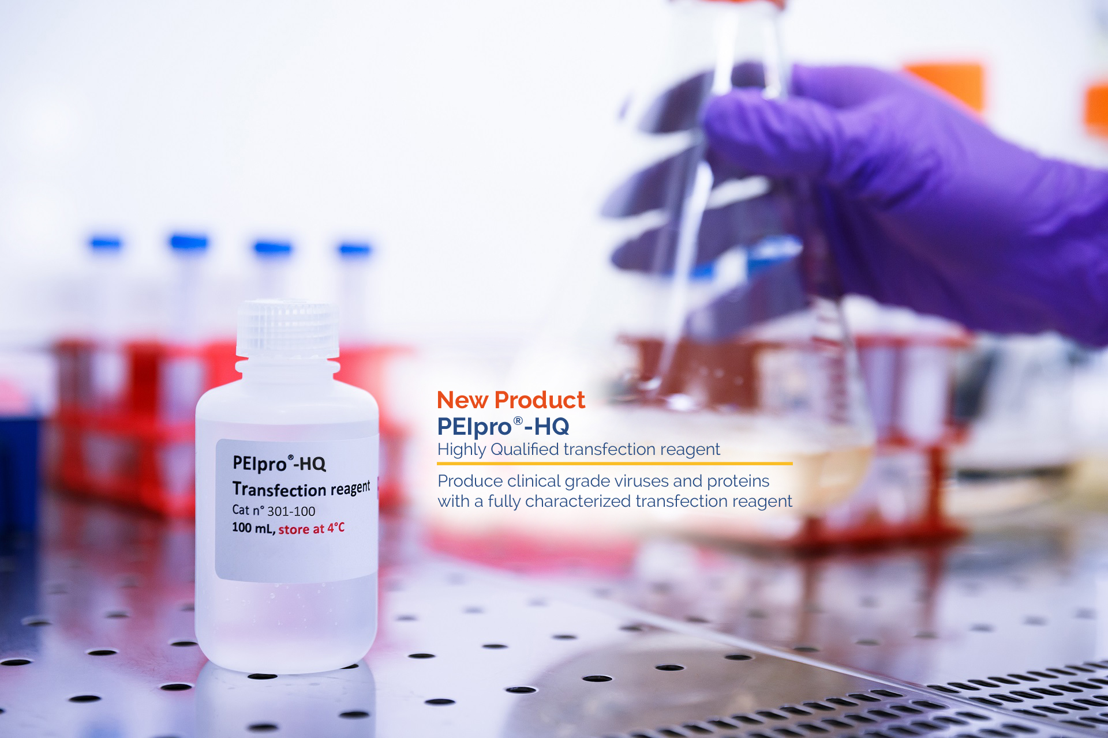
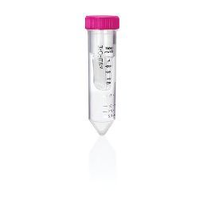
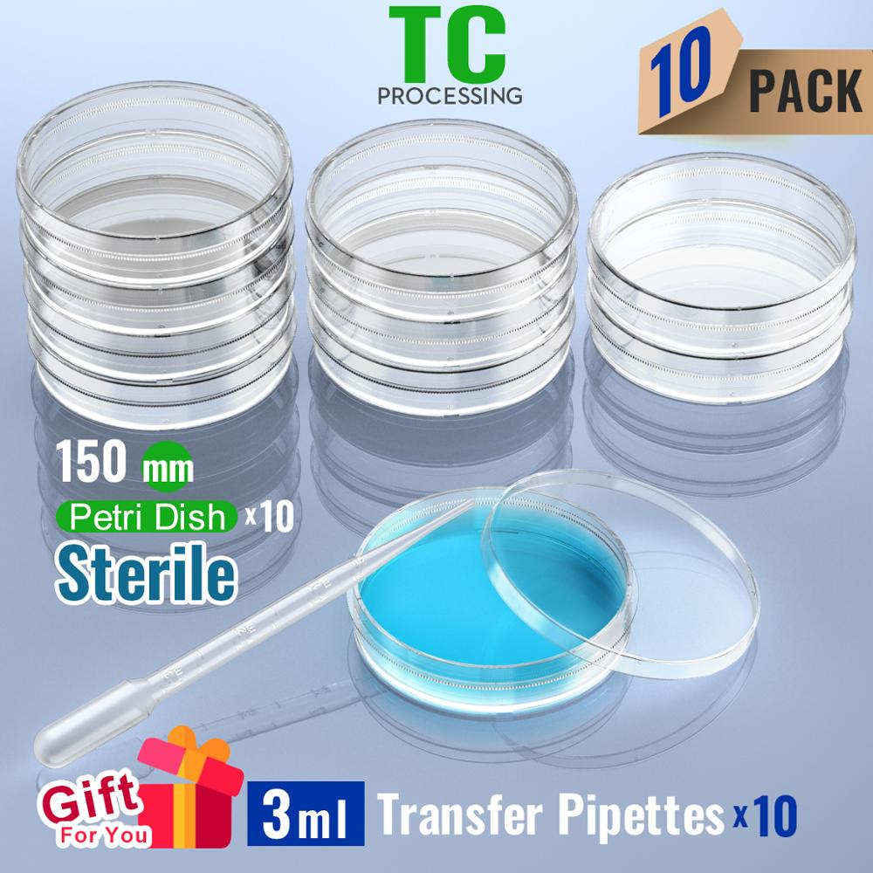
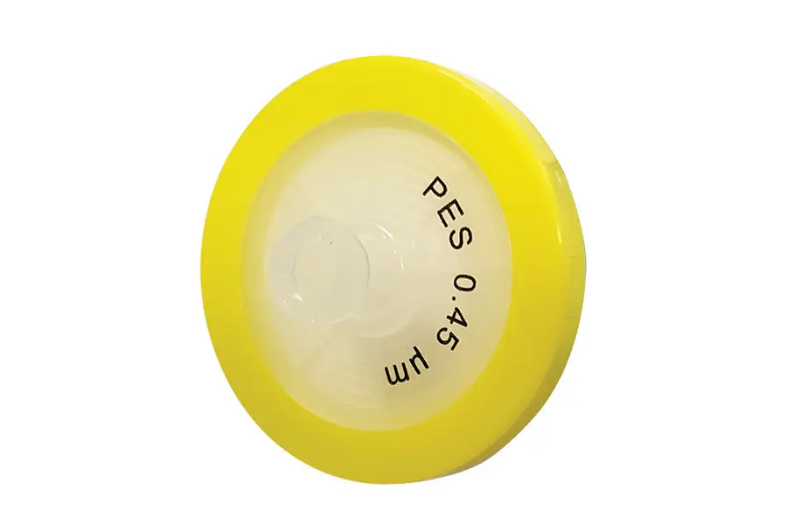
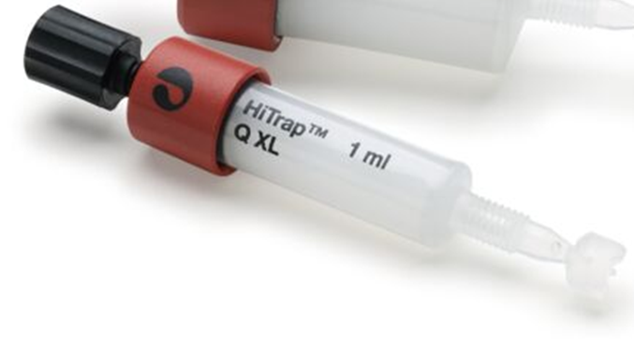
AAV production small scale
3-plasmids
Transfectant
PEIpro polyplus
Concentration and dilution : preparation for FPLC
+
Media harvest and filtration
120hrs production
Enzymatic treatment
SAN-HQ: DNase and RNase digestion
100 KDa MWCO
SA: 113.4 cm²
Volume: 20 ml
PES 0.45µm
Takes 2min
Takes 30 min
Takes 24hrs
Takes 2-3 hrs
FPLC 1st step :
collect Flow-Through
FPLC 2nd step :
collect Elution (enrichment of full capsids)
Final formulation
Flow-through dilution
Total DSP time: 8-9 hrs
Takes 2 hrs
Takes several minutes
Takes 2 hrs
Takes 30 min

Slide 3
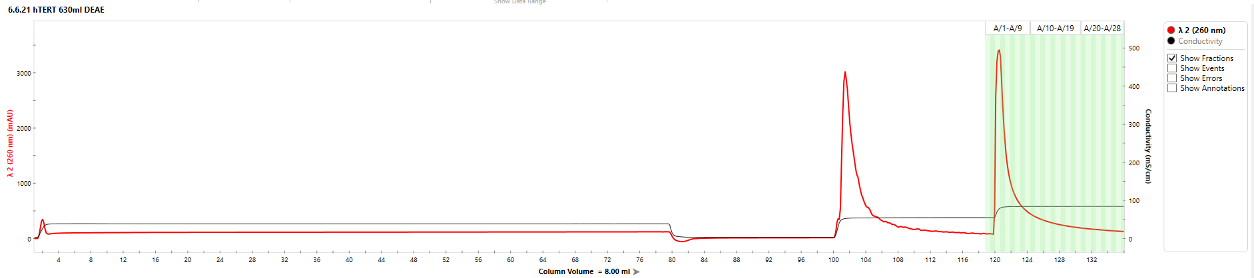
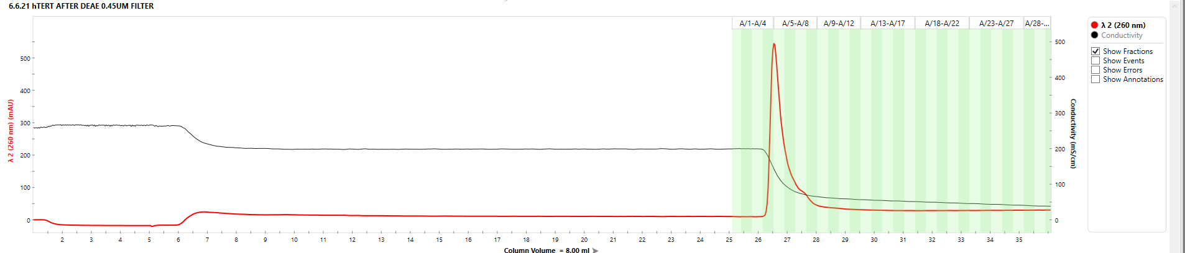
Plasmid purification – hTERT (example)
BIA seperations ; Monolith technology
Step I.
DEAE – Weak anion exchanger
Plasmid DNA
Preparative RNA
Step II.
C4 HLD–cation exchanger
Supercoiled plasmid
*Genomic DNA (Endotoxin free)
Resting plasmid

Slide 4
Efficiency comparison – FPLC-grade purified plasmids vs. kit purified plasmids
**Conductivity test
Conclusions:
Transfecting cells with FPLC-grade purified plasmids results in higher titers than transfection with purified plasmids by kit.
Harvesting crude after 120hrs, gives better physical titer than 72 hrs.
Transfecting cells with FPLC-grade purified plasmids simplify the purification method.

Slide 5
AAV production small scale
3-plasmids
Transfectant
PEIpro polyplus
Concentration and dilution : preparation for FPLC
+
Media harvest and filtration
120hrs production
Enzymatic treatment
SAN-HQ: DNase and RNase digestion
100 KDa MWCO
SA: 113.4 cm²
Volume: 20 ml
PES 0.45µm
Takes 30 min
Takes 2min
Takes 2-3 hrs
Takes 24hrs
FPLC 1st step :
collect Flow-Through
FPLC 2nd step :
collect Elution (enrichment of full capsids)
Final formulation
Flow-through dilution
Total DSP time: 8-9 hrs
Takes 2 hrs
Takes several minutes
Takes 2 hrs
Takes 30 min

Slide 6
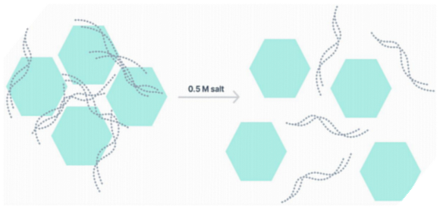
Manufacture of AAV
Many AAV serotypes are known to be prone to aggregation.
Chromatin seems to act as a “glue”, keeping AAV aggregated.
DNA is protected from enzymatic digestion. Using high salt buffers (0.5M NaCl) in purification reduces viral aggregation and releases DNA.
ArcticZymes: SAN-HQ
SAN HQ Active in high-molar environment, while Benzonase (Merck) loses its activity in this environment.
Comparison against Benzonase in our lab

Slide 7
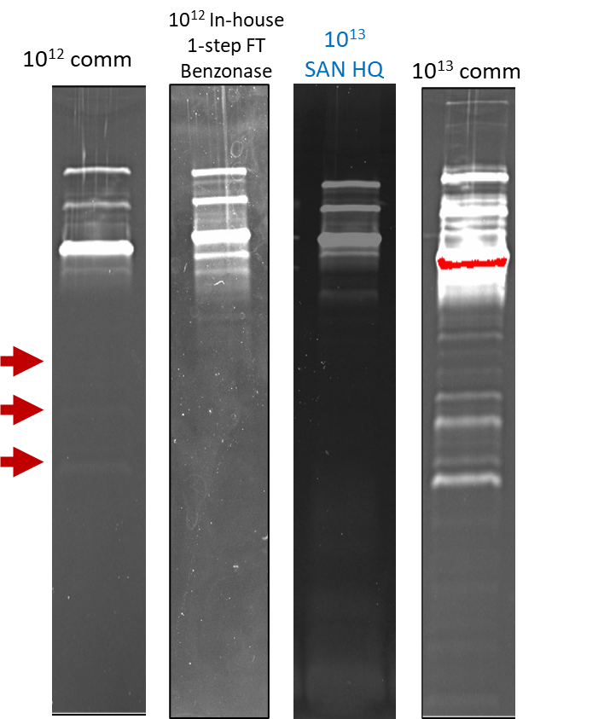
Benzonase
SAN-HQ
Flow-Through
6
7
8
9
10
11
12
13
Flow-Through
6
7
8
9
10
11
12
13
Sypro-Ruby stain
Sypro-Ruby stain
Benzonase: 200 U/ml (2-year shelf life) – 0.0122$ per 1 unit
SAN-HQ: 50 U/ml (1-year shelf life*) – 0.008$ per 1 unit
Treatment with SAN HQ improved purification of the sample in compare to Benzonase and cut the total cost of the reaction by a third

Slide 8
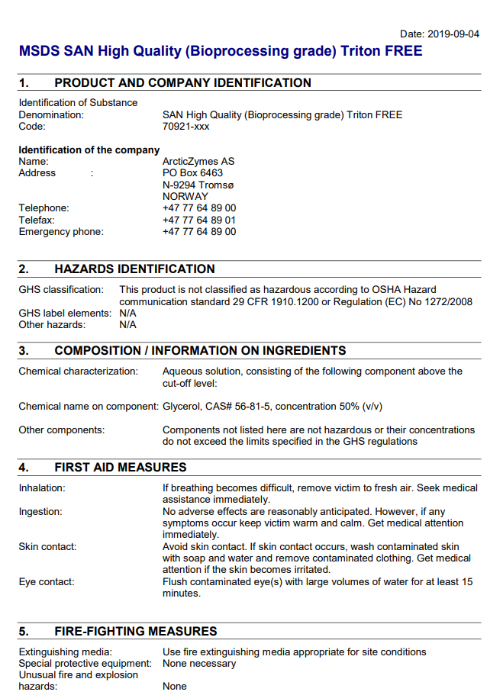

Slide 10
AAV production small scale
3-plasmids
Transfectant
PEIpro polyplus
Concentration and dilution : preparation for FPLC
+
Media harvest and filtration
120hrs production
Enzymatic treatment
SAN-HQ: DNase and RNase digestion
100 KDa MWCO
SA: 113.4 cm²
Volume: 20 ml
PES 0.45µm
Takes 2min
Takes 30 min
Takes 24hrs
Takes 2-3 hrs
FPLC 1st step :
collect Flow-Through
FPLC 2nd step :
collect Elution (enrichment of full capsids)
Final formulation
Flow-through dilution
Total DSP time: 8-9 hrs
Takes 2 hrs
Takes several minutes
Takes 2 hrs
Takes 30 min

Slide 11
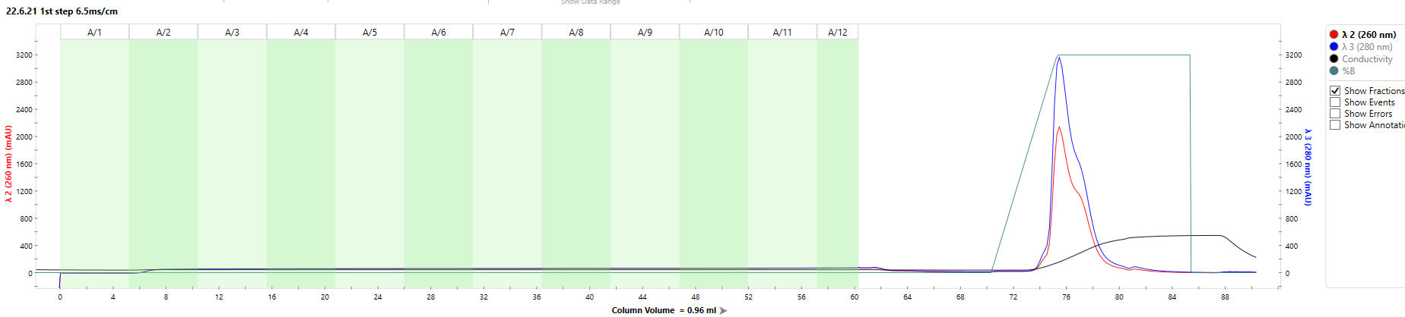
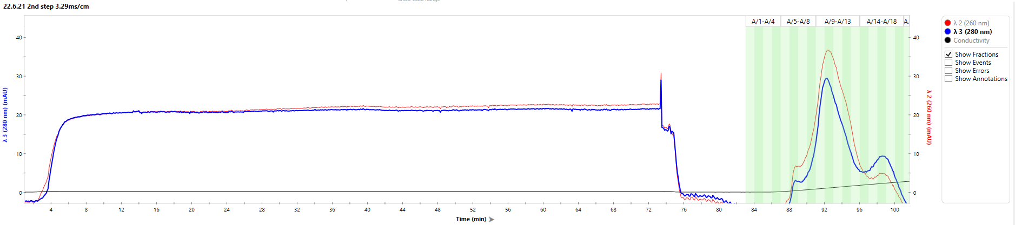
Viral particles purification - example
Cytiva; Beads technology, Q XL anion exchanger
Step I.
Neutral pH; collect flow-through
Step II.
Basic pH; collect elution (155mM NaCl)
Storage Buffer (Z buffer):
20mM Tris pH 8
200mM NaCl
1mM MgCl2
0.005% Pluronic F-68
4℃ , RT or -80℃ → Stability test

Slide 12
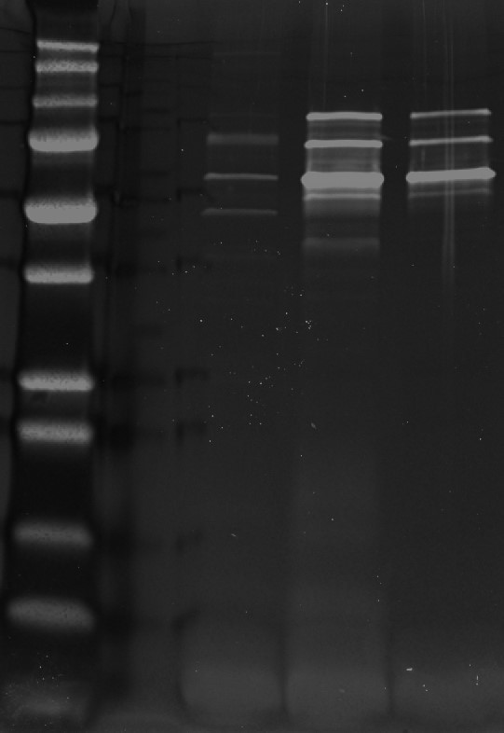
22.2.21 DMEM 2%
Hi-trap Q XL 1ml(Cytiva)
20ml Cells were transfected with 1;1;1 FPLC-grade plasmids ratio in DMEM 2%
Harvest was at 120hrs- The harvest was clarified and treated with SAN-HQ and 5mM MgCl2 in the presence of 0.5M NaCl (added 0.39M) at 37°C for 30min. Conductivity at loading was 6.7ms/cm and Pass-through fraction was collected
FT
uc
FT
c
FT
c (14.2)
Ruby staining
Storage Buffer (TNMP/Z buffer):
20mM Tris pH 8
200mM NaCl
1mM MgCl2
0.005% Pluronic F-68
4℃ → Stability test ; physical titer kept for 8 weeks
Western blot

Slide 13
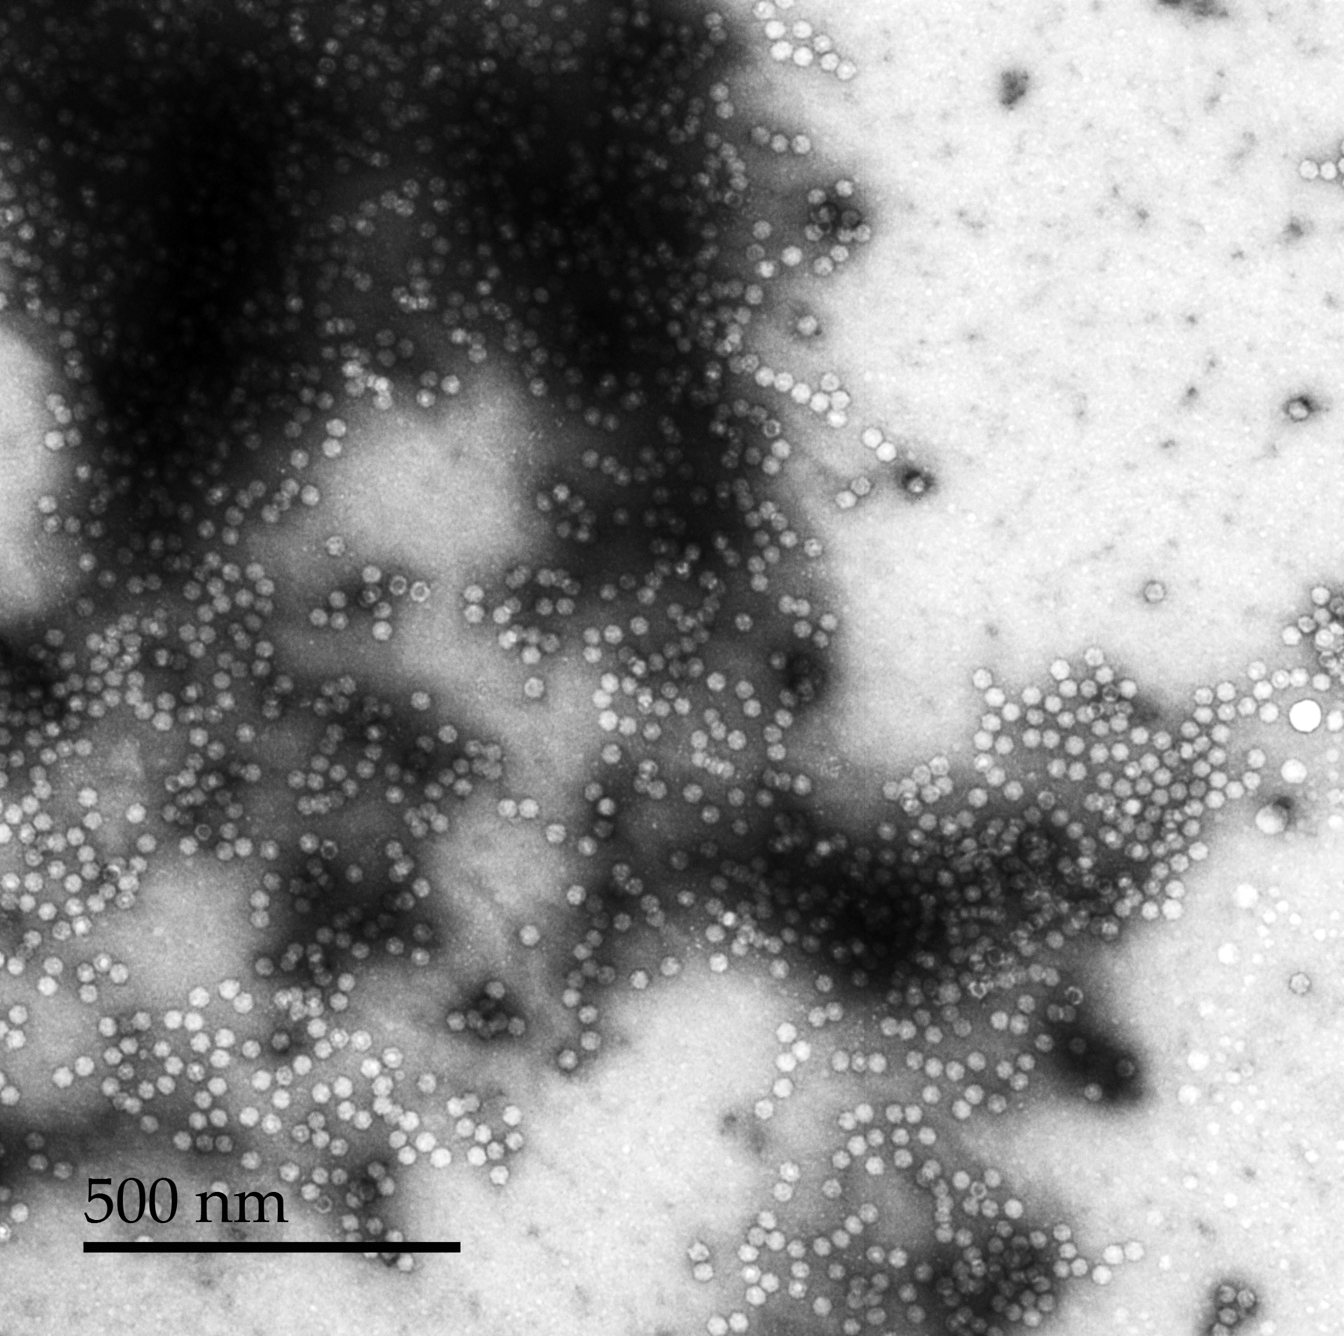
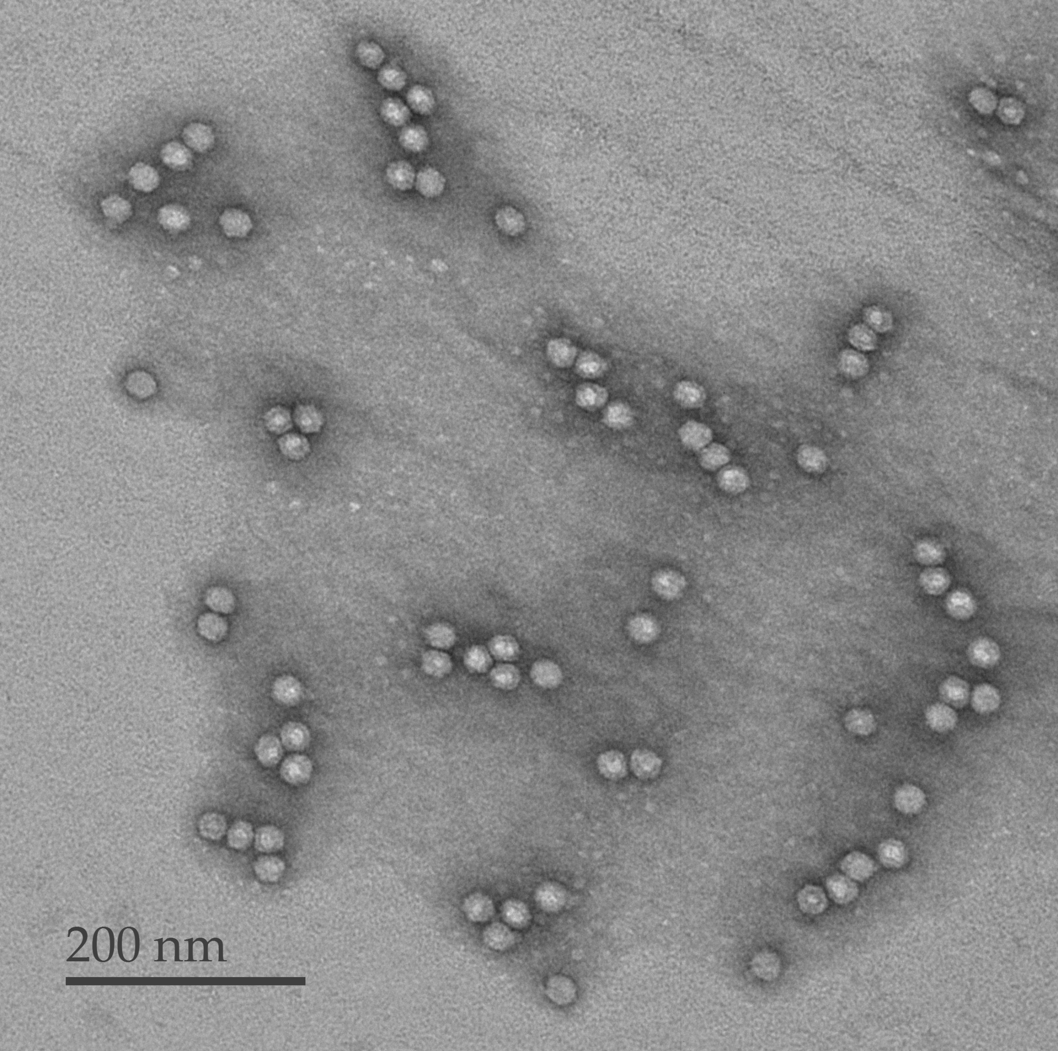
EM analysis: Commercial vs. ‘in-house’ AAV-hTERT
Samp. H H20 (-) | Samp. Z H20 (-)
Much salt Good scattering Less clean Many viruses (2x10¹³ VGs/ml) Many full viruses | Seemed w/o noticeable debris Aggregates abundant (1x10¹³ VGs/ml) Lower resolution 200nm vs/ 500nm in other samples
125/129 1278/1294 427/437 Total: 1830/1860 | 13/14 71/71 8/12 23/24 6/6 Total: 121/127
%Full viruses: 98% | %Full viruses: 95%

Slide 14
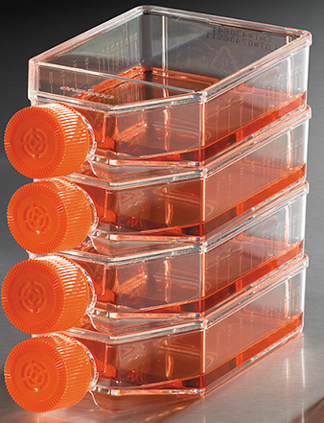
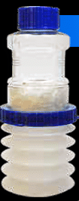
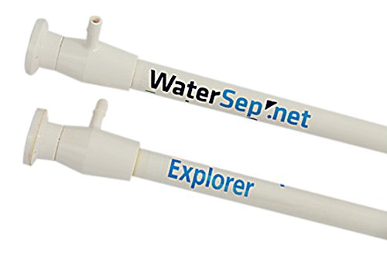
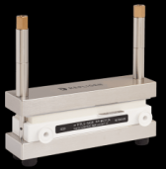
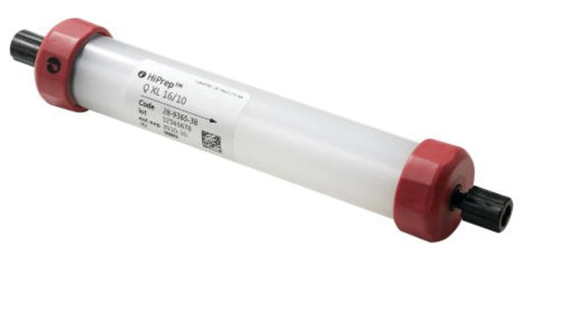
AAV production scaling up: 0.5 L
3-plasmids
Transfectant
Cell growth
+
PEIpro polyplus
Media harvest and filtration
120hrs production
Enzymatic treatment
SAN-HQ: Dnase and Rnase digestion
SA: 13200 cm²
Volume: 500ml
Takes 30 min
Takes 4-7 days
Takes 30 min
Takes 24hrs
Concentration and dilution : preparation for FPLC
FPLC 1st step :
collect Flow-Through
FPLC 2nd step :
collect Elution (enrichment of full capsids)
Final formulation
Flow-through dilution
100 KDa MWCO
100 KDa MWCO
Takes 30-40 min
Takes 6 hrs
Takes several minutes
N/A
N/A

Slide 15
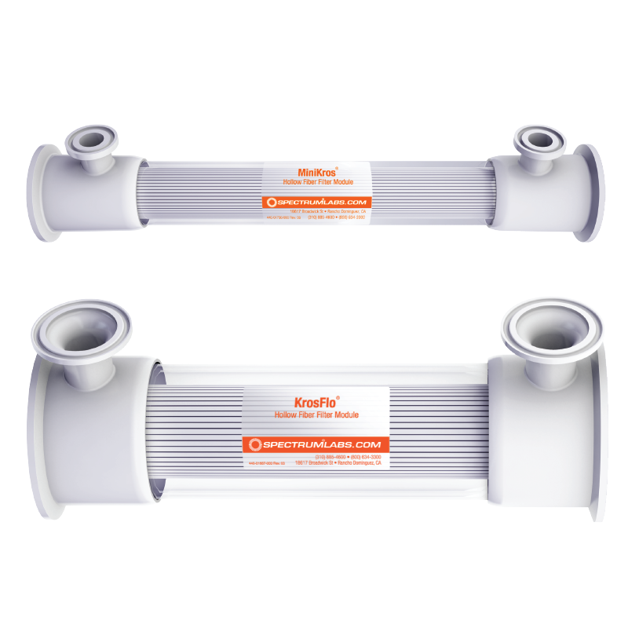
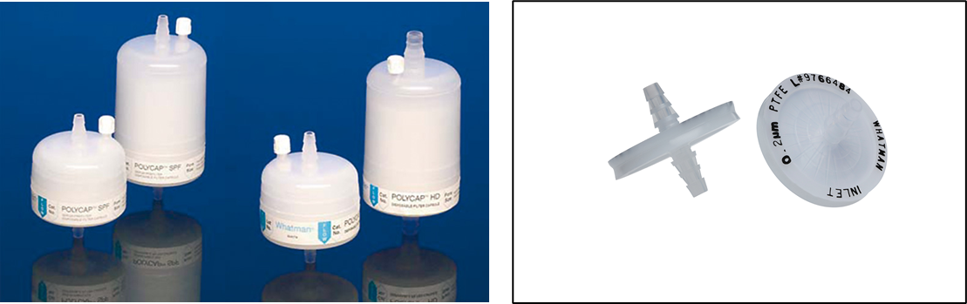
Crude Clarification
PES
Depth filters
Hollow fiber
Final pore size:
0.2 µm
0.45 µm
0.65 µm
Dead end filters
Time of clarification was high (1.5- 2hrs for 0.5 L)
Complex procedure (required 3 sizes; 5µm, 1µm and 0.45µm)
Very efficient
Reusable
Time of clarification was low (0.5 hr for 0.5 L)
Simple procedure
Efficient
We faced several problems to analyze the quality of the sample after clarification : Solution- 2D ddPCR

Slide 16
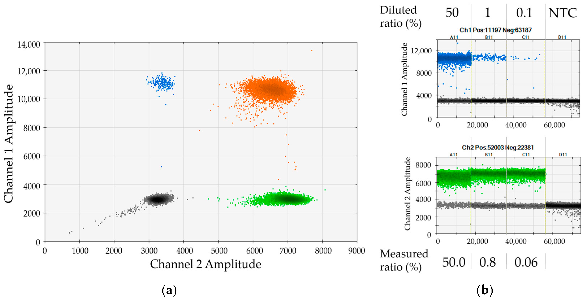
2D ddPCR
Blue channel - GOI (hTERT)/ Ori (Plasmid)
Green channel - ITR
Intact DNA
-/+
+/+
-/-
+/-
https://www.mdpi.com/1422-0067/17/9/1515/htm
This method provide absolute quantification of Viral titer
In this method, four populations can be differentiated, so full capsids can be quantified in the sample (Unlike the qPCR, which only provides the physical titer)
This method can also provide quantification of plasmid contamination in final sample
This method may be more suitable for stability tests than qPCR

Slide 17
28.7.21
2D ddPCR ANALYSIS
Reflects qPCR results
0.2um is too small
Full capsid’ yield is low

Slide 18
3.8.21
2D ddPCR ANALYSIS
0.45um have shown better % of full capsids

Slide 19
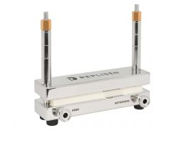
Crude Concentration and Diafiltration
Cassettes
Hollow fiber
MWCO:
100 KDa
Reusable
Time of clarification was low (15 min for 0.5 L)
high efficiency (3 repeats , > 70% yield)
Reusable
Time of clarification was high (over 1hr for 0.5 L)
Low efficiency
Cassettes are compatible with higher shear forces than hollow fibers- That allows shorter scalability times and ability to process high volumes.
The AAV is a non-membrane virus, hence, more resistant to high shear forces than other viruses.

Slide 20
Strategies for sample preparation (pre-FPLC)
Small scale (20ml)- concentration 4-5 fold and dilution with equilibration buffer (MHN pH 8)
Large scale-
Concentration fivefold and diafiltration with equilibration buffer (MHN pH 8) – keeps low volumes (decreased chromatography times); in 2D ddPCR showed high disintegration of the capsids
Concentration fivefold and dilution with equilibration buffer (MHN pH 8) – initial high volume for chromatography (long running times); in 2D ddPCR showed high disintegration of the capsids and low recovery in FPLC
Diafiltration with equilibration buffer (MHN pH 8)- long running times in chromatography; in 2D ddPCR showed better preservation of the intact capsids.- needs optimization

Slide 21
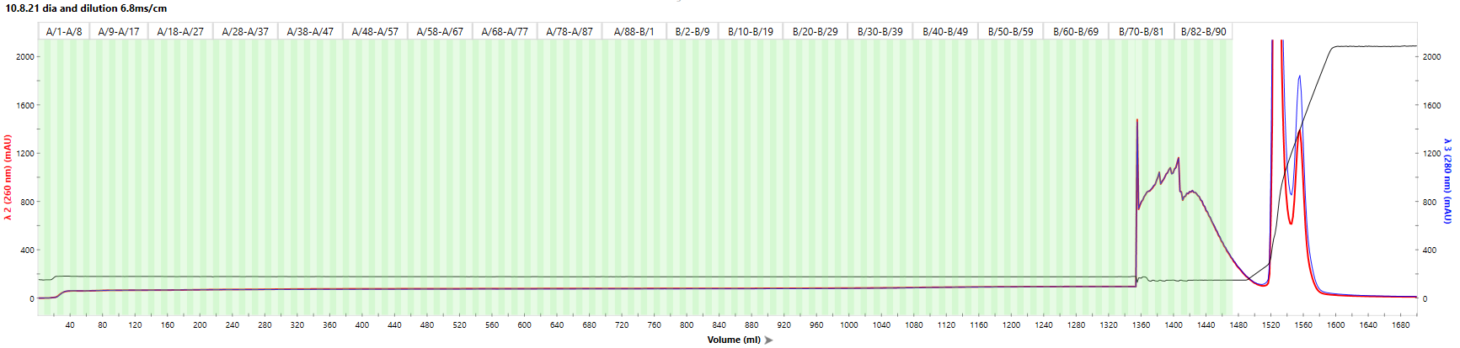
10.8.21 TFF trial : reg plasmids: hTERT-CMV, fibracel , 2.3x10⁸ cells, 2.5mg DNA, PEI;DNA ratio- 1;1
Clarification: Watersep 0.45uc 320.6 cm^2
Concentration and Diafiltration: TangenX cassettes, 100um, pes, 0. 1m^2
10.8.21 Purification steps (Q-XL)
1st Run
Flow-Through
Wash
Conductivity 7 mS/cm
Conductivity 5.6 mS/cm
Analysis:
qPCR
2D ddPCR
Western
Ruby

Slide 22
10.8.2021
qPCR
2D ddPCR
Full capsids
Conclusions:
TangenX cassette was hacked – probably due to long CIP
0.45um pore size is suitable for initial clarification
Sample that was diafiltrated w/o initial concentration kept the capsids intact – might need to consider lowering flowrate for optimization
In purification step: decreased conductivity and prolonged wash step may improve recovery acc. To ddPCR results

Slide 23
AAV production scaling up: 0.5 L
3-plasmids
Transfectant
PEIpro polyplus
Cell growth
+
Media harvest and filtration
120hrs production
Enzymatic treatment
SAN-HQ: Dnase and Rnase digestion
SA: 13200 cm²
Volume: 500ml
PES 0.45µm
Takes 4-7 days
Takes 30 min
Takes 30 min
Takes 24hrs
Good separation relies on column dimensions
Concentration and dilution : preparation for FPLC
FPLC 1st step :
collect Flow-Through
FPLC 2nd step :
collect Elution (enrichment of full capsids)
Final formulation
And sterilization
Flow-through dilution
100 KDa MWCO
100 KDa MWCO
Takes 30-40 min
Takes 6 hrs
Takes several minutes
N/A
N/A

Slide 24
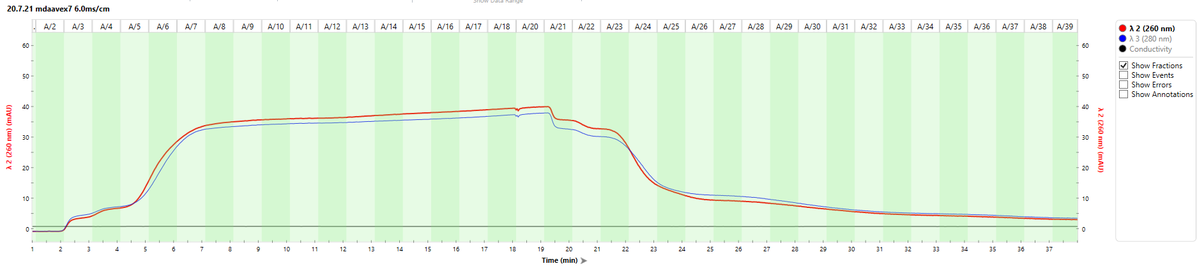
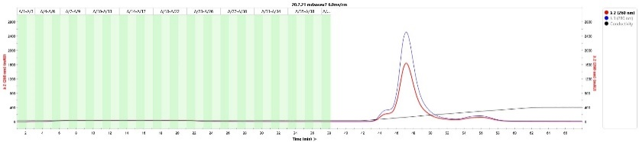
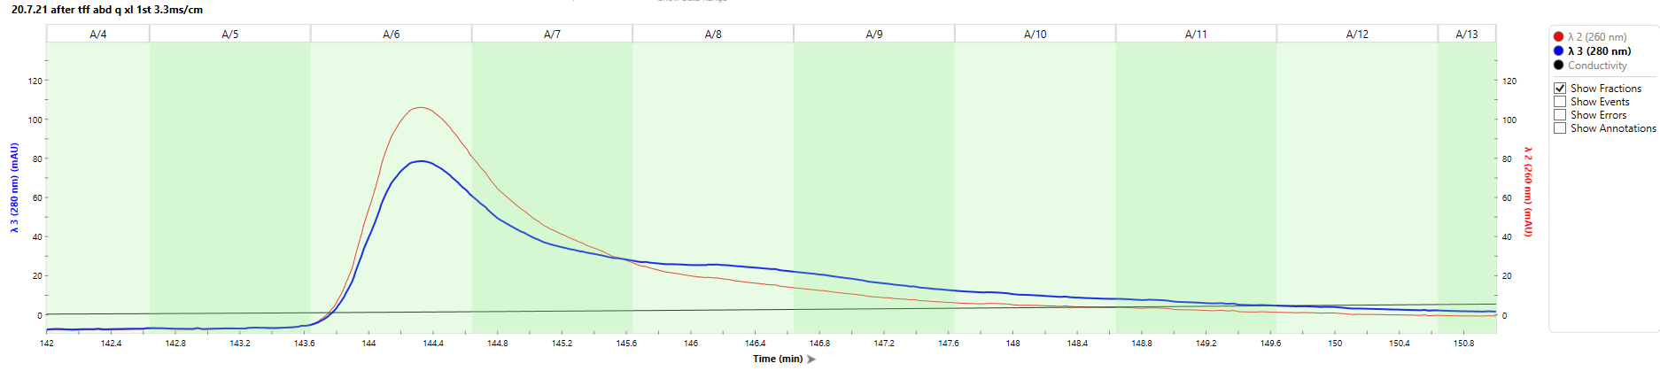
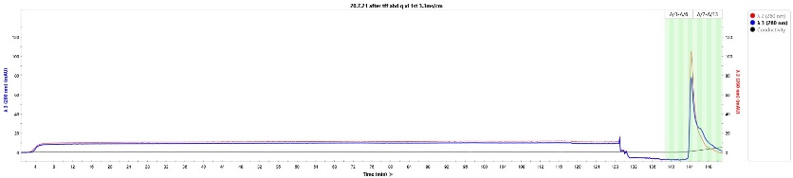
20.7.21 TFF trial reg plasmids: hTERT-CMV, fibra-cel, N/A cells
Clarification: midikros 0.2 290cm^2
Concentration and Diafiltration: TangenX cassettes, 100um, pes, 0. 1m^2
20.7.21 Purification steps (Q-XL)
Flow-Through
1st Run
Needed longer wash period
Lower separation than small scale
2nd Run
Formulation: Ultracel 100KDa with Z buffer

Slide 25
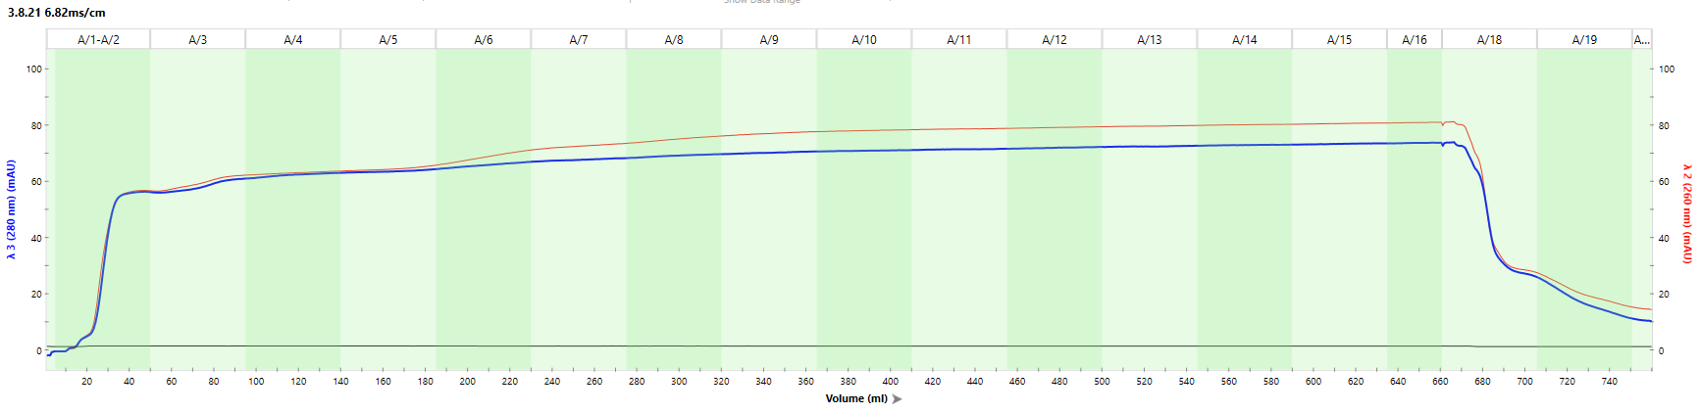
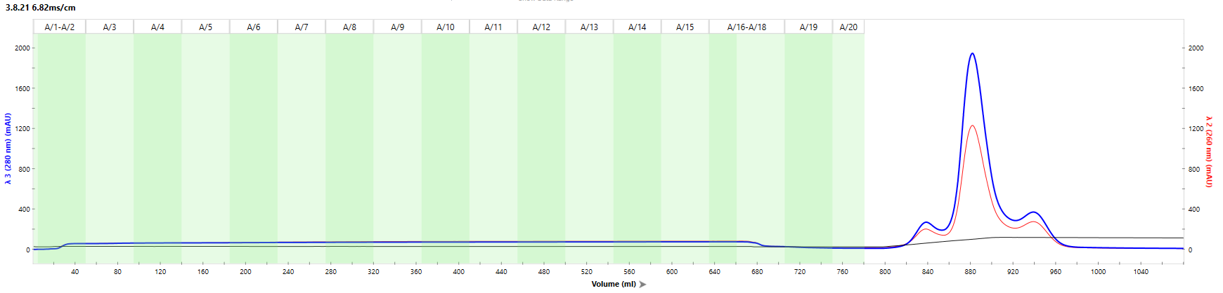
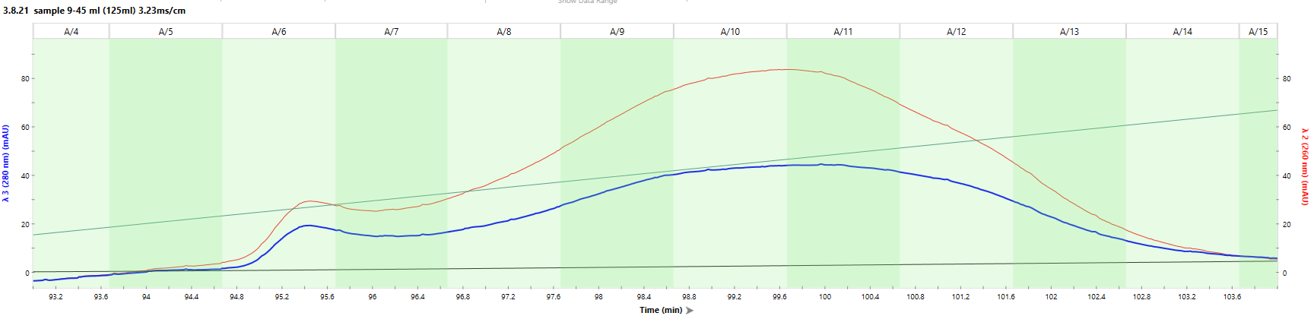
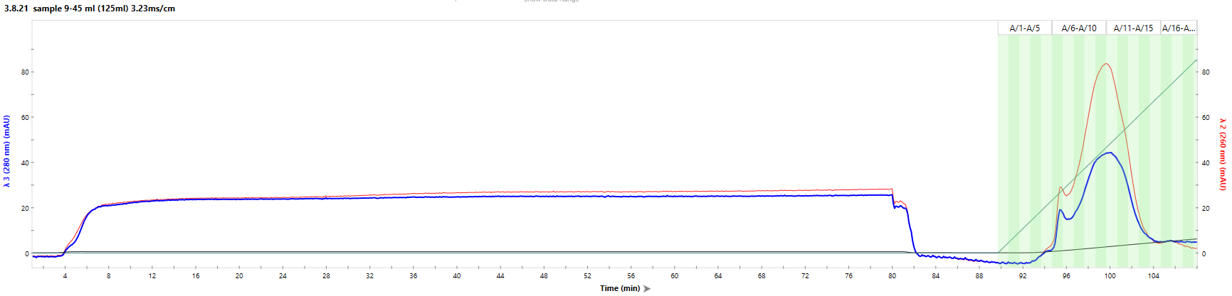
3.8.21 TFF trial : reg plasmids: hTERT-CMV, fibracel , 4.6x10⁸ cells, 1.25mg DNA, PEI;DNA ratio- 2;1
Clarification: Watersep 0.45uc 320.6 cm^2
Concentration and Diafiltration: TangenX cassettes, 100um, pes, 0. 1m^2
28.7.21 Purification steps (Q-XL)
Flow-through 6.82mS/cm
1st Run
Sample 9
2nd Run
Formulation: Ultracel 100KDa with Z buffer

Slide 26
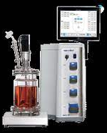
AAV production scaling up: 3 L (~ 100L)
3-plasmids
Transfectant
Cell growth
+
Media harvest and filtration
120hrs production
Enzymatic treatment
SAN-HQ: Dnase and Rnase digestion
N/A
SA: 79200 cm²
Volume: 3000ml
PES 0.45µm
Takes 30 min
Cell growth kinetic needed
(At work)
N/A
Biochemical analysis system (cooperation with Eppendorf)
Concentration and dilution : preparation for FPLC
FPLC 1st step :
collect Flow-Through
FPLC 2nd step :
collect Elution (enrichment of full capsids)
Final formulation
And sterilization
Flow-through dilution
100 KDa MWCO
100 KDa MWCO
N/A
N/A
Takes several minutes
N/A
N/A

Slide 27
Challenges in development
Increasing full/empty capsid ratio
Purified and active product
High titer
Cost-effective process
Product shelf-life (stability test; qPCR/2D-ddpcr/ Transductivity test/pH)
Contaminants free process (adventitious reagents throughout the process and in final product)

Slide 28
Sample analysis
Better analysis gives us the option to diagnose the source of the problems we face through development
In turn, that may shorten times and decrease costs of the development process

